Slide 1
MALIGNANT COMMENT CLASSIFIER
Submitted By –
Vikas Ojha

Slide 2
Introduction
People use social media as a platform to express their opinions and views.
However, at the same time, this has resulted in the emergence of conflict and hate, making online environments uninviting for users.
Online hate, described as abusive language, aggression, cyberbullying, hatefulness and many others has been identified as a major threat on online social media platforms.
Our goal is to build a prototype of online hate and abuse comment classifier which can used to classify hate and offensive comments so that it can be controlled and restricted from spreading hatred and cyberbullying.

Slide 3
Multi-label Classification
This is a multi-label classification problem, where the data can belong to more than one label. Thus, in this dataset the comment can be of one or more categories.
The goal of the multi-label classification is to determine whether or not a comment is toxic or non-toxic. If toxic, to determine what kind of toxicity the comment is, like-in, malignant, highly-malignant, threat, rude, abuse or loathe. Thus, a model needs to be created in order to differentiate between comments and its categories.

Slide 4
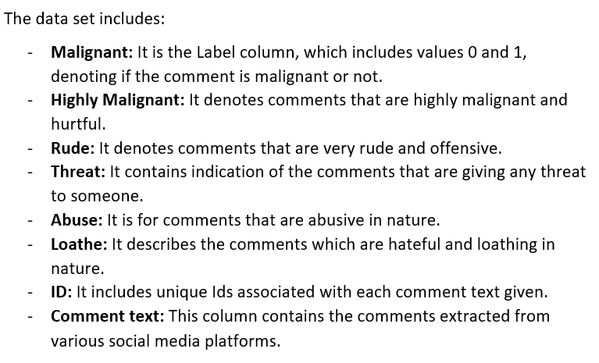
The Dataset
The data set contains the training set, which has approximately 1, 59,000 samples and the test set which contains nearly 1, 53,000 samples.
All the data samples contain 8 fields.

Slide 5
Data Pre-Processing
Dropping the column
Handled the missing values, if any
Creating new feature
Clean the data

Slide 6
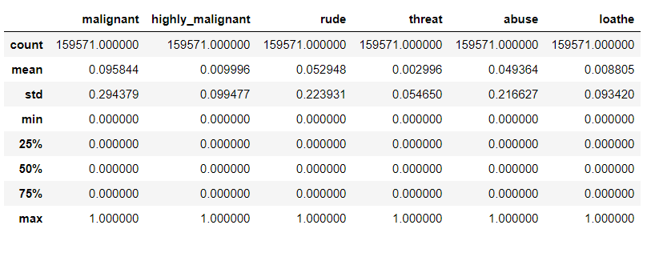
Statistical Summary
Statistical analysis summarize and provide information about the sample data. It is obtained by using describe().

Slide 7
Null Values
The null values are checked using isnull().sum() function and visualizing the same using heatmap which results in getting no features having null values in actual.

Slide 8
Cleaning the Data
Replaced the extra lines or ‘\n’ from the text.
Transform the text into lower case.
Replaced the email addresses with the text 'emailaddress'
Replaced the URLs with the text 'webaddress'
Removed the numbers
Removed the HTML tags
Removed the punctuations
Removed all the non-ascii characters
Removed the unwanted white spaces
Removed the remaining tokens that are not alphabetic
Removed the stop words
Tokenized the text into words
Lemmatized the words

Slide 9
Splitting train and test data
x representing the independent/input variables which is ‘comment_text’.
y represents the dependent i.e. target variable which are 6 labels named malignant, highly_malignant, rude, threat, abuse and loathe.
The train and test data is divided into 80% and 20% respectively.
‘test_x’ represents the test data for which the predicted values will be stored.

Slide 10
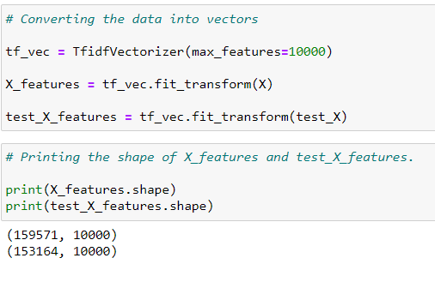
Vectorization
The data is vectorized using TF-IDF vectorizer.
‘x’ for train data and ‘test_x’ for test data was fitted into it and converted into an array with 10,000 maximum features.

Slide 11
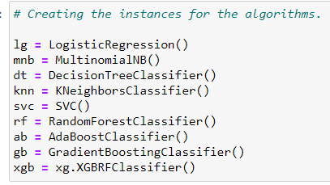
Algorithms

Slide 12
Metrics
Accuracy
Hamming Loss
Log Loss
Classification Report
Precision
Recall
F1 - Score

Slide 13
Testing of Identified Algorithms in different ways
Firstly, the algorithms are trained and tested label-wise, for which a function is defined, which results in all the metrics used in order to find the best model, for each label.
Next, the models were trained and tested on an overall basis in order to have an overall results of the algorithms used.
As it is a multi-label classification problem, the methods to solve such type of classification are also used. The methods used are:
Binary Relevance
OneVsRestClassifier

Slide 14
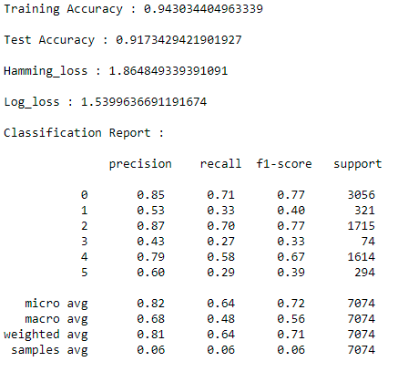
Results
Logistic Regression using oneVsRestClassifier is giving test accuracy of 91.73% and thus, selected as a best model for this data.

Slide 15
Predicting the values using the selected model
The values are predicted of all the target variables or labels, with Logistic Regression using OneVsRestClassifier.
Then, converted the predicted values into a dataframe

Slide 16
Conclusion
In this project, several Classification models are built to predict the labels of the category of toxic comments.
This is a Machine Learning Approach combined with Natural Language Processing (NLP) for toxicity detection and its type identification in user comments.
The Mean Validation Accuracy, so obtained, is 91.73% which is by far the highest ever numeric accuracy reached by any Comment Toxicity Detection Model.
The research done in this project is intended to enhance fair online talk and views sharing in social media.

Slide 17
Thank You!

